Slide 1
Team 3
Kenny Pham
Ryan Granston
Yu Takahashi

Slide 2
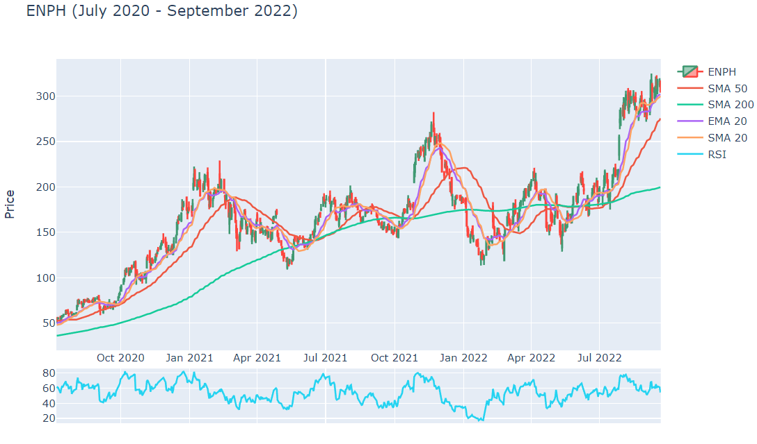
Stock Screener
CLI application
Use Technical Analysis to create a filter
Apply the filter to a stock index
Export the selected stocks to an interactive view
Supply fundamental analysis to support decision making
Notes:
Here is our project summary. We are creating a stock screener. Please note, this is not financial advice. We created a CLI application, that prompts the user to choose a stock index, filters through the stocks in the index using technical analysis indicators. The application then exports its findings to a web browser with an interactive display that shows both technical and fundamental analysis to support the users decision making.
Now I’m sure you’re wondering how does this relate back to fintech? Will some of us took this class to find a new career, others are looking for new and exciting ways to degenerately gamble on the stock market.

Slide 3
Data Collection
get_balance_sheet()
get_cash_flow()
get_income_statement()
get_live_price()
get_financials()
get_quote_data()
tickers_dow()
tickers_nasdaq()
tickers_other()
tickers_sp500()
Yahoo_fin
Quick and easy to install
Free
Fundamental stock data
Three Modules
Stock_info
Options
News
Notes:
The api that we settled on is Yahoo_fin. Yahoo_fin pulls market data from Yahoo finance. Some of you might be surprised that yahoo still exists but I promise yahoo finance still a good tool to use. Yahoo_fin allows you to pull market data including stocks, traditional currency and cryptocurrency. It’s free which is great but it can be pretty slow. It comes with three modules: stock_info, options and News. On the right we have some of the different functions the tool can perform.

Slide 4
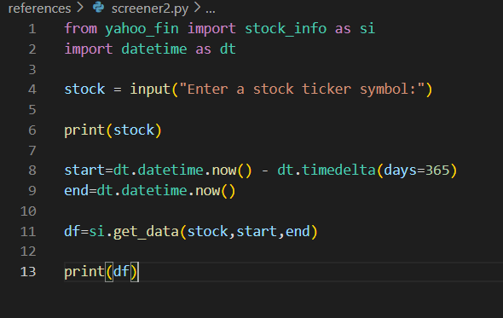
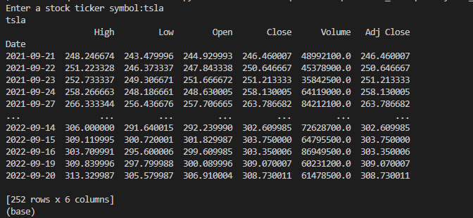
Data Collection: Yahoo_fin
Notes:
Here is an example of how it works. Simply input a stock ticker, and it will pull a years worth of data. Note that for 365 days it only pulls 252 rows, as the tool does count weekends, unlike some of the projects that we have done in class.

Slide 5
Data Clean-up
TA-Lib
Performs technical analysis
Large library of indicators
SMA
EMA
RSI
Functools: reduce()
Combine multiple values
Solved “levels” issue from pd.concat()
Notes:
Yahoo_fin is purpose built for what we are trying to accomplish so there wasn’t much to do for data clean-up in our database.
However building our technical indicators manually created a mess of code, and really slowed down our application. To help clean that up we found TA Library to perform our technical analysis.
Another issue we faced was an error message we would get when using pandas concat, which we overcame by implementing functools reduce.

Slide 6
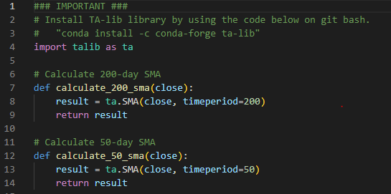
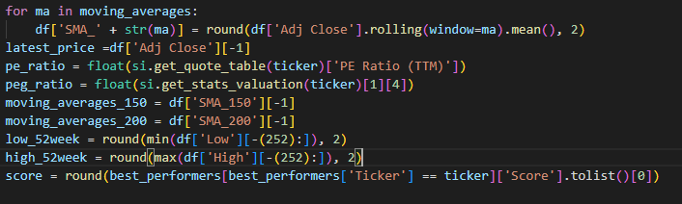
Data Clean-up: TA-Lib
Notes:
Here is a before and after of our TA Library code cleanup.

Slide 7

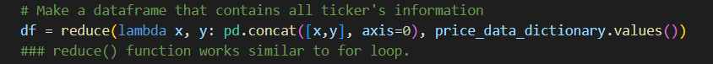
Data Clean_up: reduce()
Discovered in yahoo_fin official documentation
Notes:
Before: this for loop exists in another for loop, which could result in slower performance. Also, getting "Cannot concat indices that do not have the same number of levels" error while working on it, so I switched to reduce() function
After: single line, basically adding new value(y) into sum of the old values(x)

Slide 8
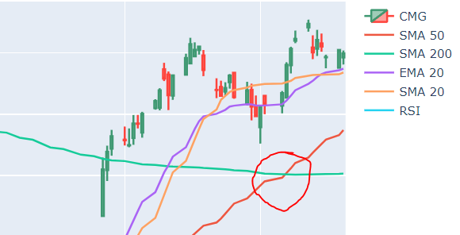
Data Exploration
How do we find a Golden Cross:
Golden Cross is a bullish indicator.
Typically when a 50 MA moves above a 200 MA.
Potentially signaling a confirmation of a reversal.
We will use this as our buy indicator.
How do we code this into our filter?
Notes:
We now have access to a ton of information, so now how do we filter the stocks out that we want.
What we’re looking for is a ‘Golden Cross’ indicator. A golden cross happens when a sharter moving average crosses a longer moving average. This can confirm a reversal or indicate a momentum play. This will be used as our ‘buy’ indicator.

Slide 9
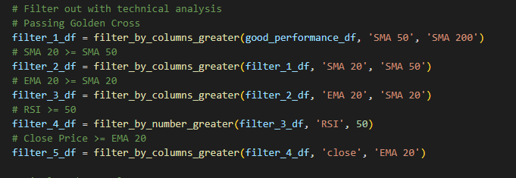
Data Exploration
Custom filters
Find Golden Cross
Additional filters
20-day SMA >= 50-day SMA
20-day EMA >= 20-day SMA
RSI >= 50
Closing price >= 20-day EMA
Notes:
Here is a quick breakdown of our filter. Not only does it use the golden cross indicator but it also uses simple and exponential moving averages, along with the relative strength index to further filter into stocks we believe are going to be a ‘buy’.

Slide 10
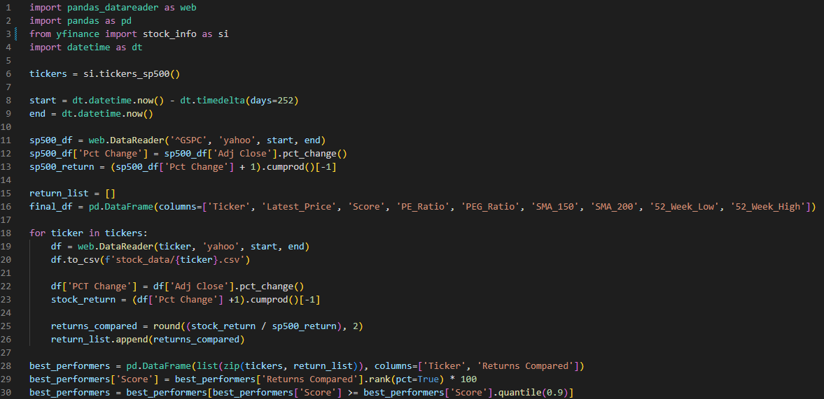
Group Approach
Data Collection:
Settled on our api idea.
Original api out of date.
Significant issues in our rough draft.
Load times unacceptable.
Notes:
For our group approach we divided the project into three sections: data collection, cli application, and jupyter lab display and analysis.
For data collection after we settled on our api idea we ran into some issues with outdated yahoo finance tools. There were some workarounds but eventually we found a better supported tool in Yahoo_fin.
From here we were able to create a rough draft of our filter but ran into a lot of issues, with the main one being load times. Our original app would take 20-30 minute to run.

Slide 11
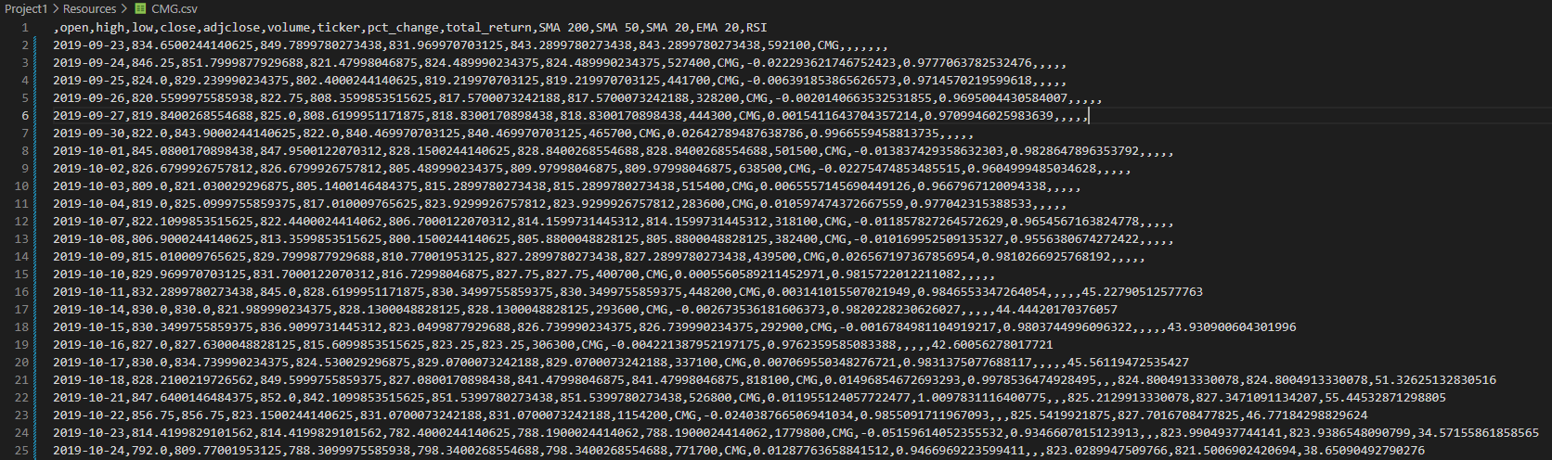
Group Approach
CLI Application:
Our App is functioning.
Load times significantly reduced.
All output is in text.
Not user friendly.
Notes:
After cleaning up our code. Adding TA Library. We finally had our application load times down to around a minute. The filters worked, we saved all of our stock information into csv files. But at this point the data was not user friendly.

Slide 12
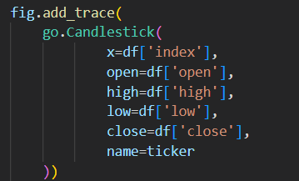
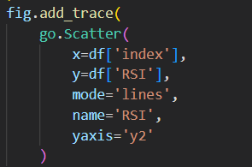

Group Approach
Jupyter Lab Interactive Display:
Researched visualization options.
Discovered Voila.
Jupyter Lab from a terminal application.
Web Browser interface.
Notes:
We need to still analyse the data and present it to the user and wanted to use jupyter lab to do so. This is where we discovered Voila. Voila let’s us run a jupyter lab file from within our CLI application and displays the information in a web browser. Now we needed to convert our graph into candlesticks, display our technical analysis and include our fundamental analytics.

Slide 13
Demonstration

Slide 14
Next Steps
Build out additional options for the screener.
Modularize filtering part of run() function so that it can let user to select technical indicators.
Make user to download historical data in SQLite format on first run, then update the database everyday to make the application run faster.
Research on how to run the program constantly to get the realtime information.
Make the program to send notifications via text or email.
Identify patterns.

Slide 15
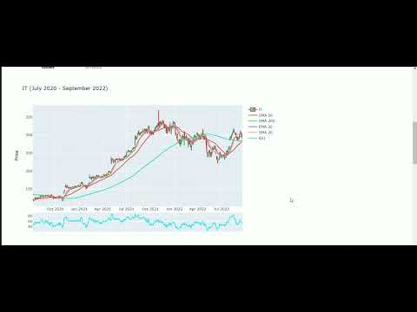
Notes:
Back up video if short on time.

